Slide 1
Hop Breeding
Why, how, and the impact of new variety evaluation and selection
Jason Perrault
jason@selecthops.com
www.selecthops.com

Slide 2
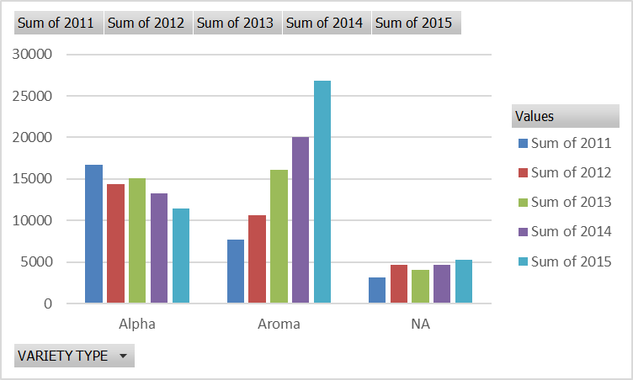
Acreage Trend: aroma versus alpha
Aroma hop acreage increasing
  Role reversal
Bitter/Alpha hops declining cyclically
Acreage at near record highs

Slide 3
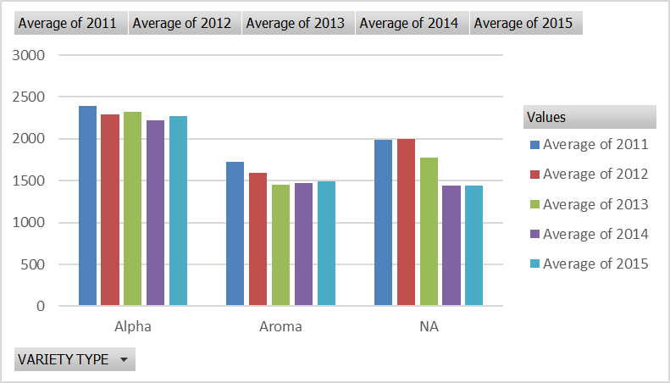
Average Yields (# per acre): aroma versus alpha
Aroma varieties yield less.
Resource strain.

Slide 4
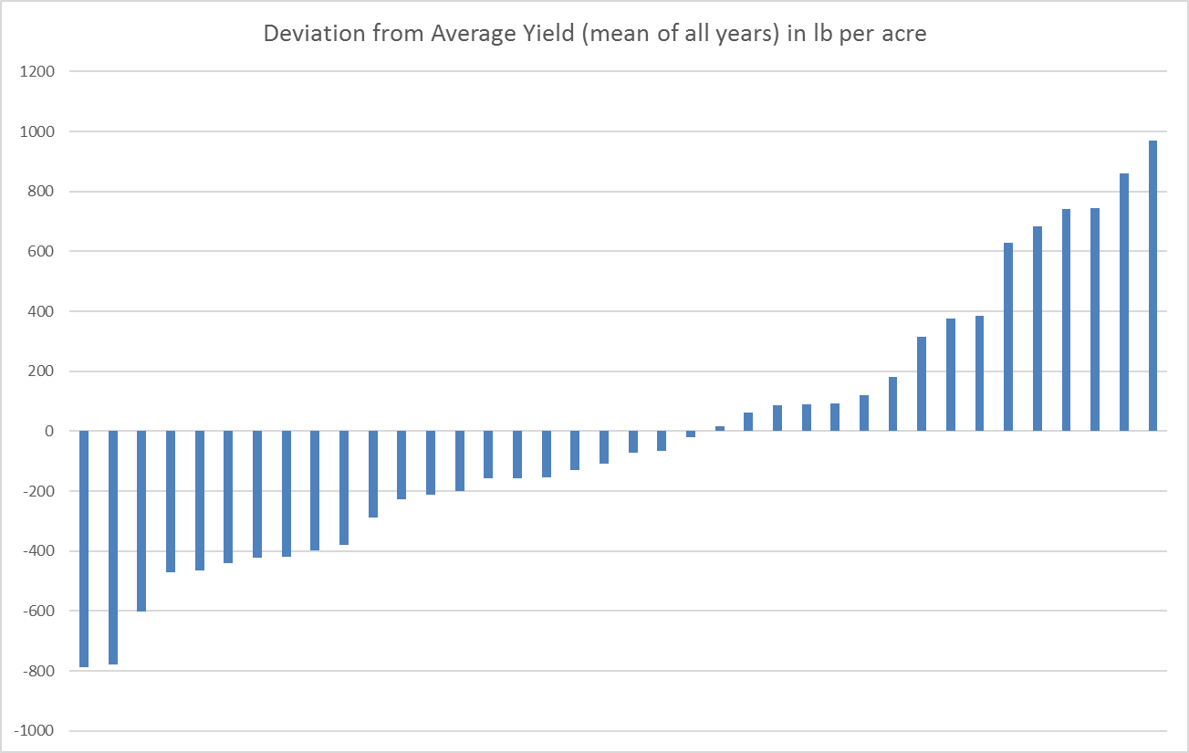
Alpha Hop Efficiency
With the exception of Mosaic® and Palisade®, the top 10 producers are “super” alpha varieties.
  These varieties offer efficiency for both growers and brewers!
Note: Perle removed as no ‘15 production was reported

Slide 5
Average Yields: deviations from the mean
Picking on the bottom 5:
  1. Golding
  2. Fuggle
  3. Tettnanger
  4. Northern Brewer
  5. Centennial
Note: Perle removed as no ‘15 production was reported

Slide 6
Varietal Impact
Physiology and development are genetic.
Crop management is varietal dependant.
There is a strong genetic x environmental interaction.
The goal: Realize the maximum genetic potential.
The problem: Maximum genetic potential cannot be reached in all environments.
Answer is breeding and selection

Slide 7
How important is this?
Hop Supply Chain: Each link on the supply chain affects subsequent links.
  The efficiency of a hop has a corresponding impact on the chain.
Breeding
Program
New Variety:
Good yield
Disease resistant
Good quality
Stores well
Farm
Cost/Acre
Yield
COST/UNIT
Handler
Cost
Storage
Pellet Recoveries
Extract Recoveries
Shipping
Brewery
Efficiency
Quality
Flavor
Cost

Slide 8
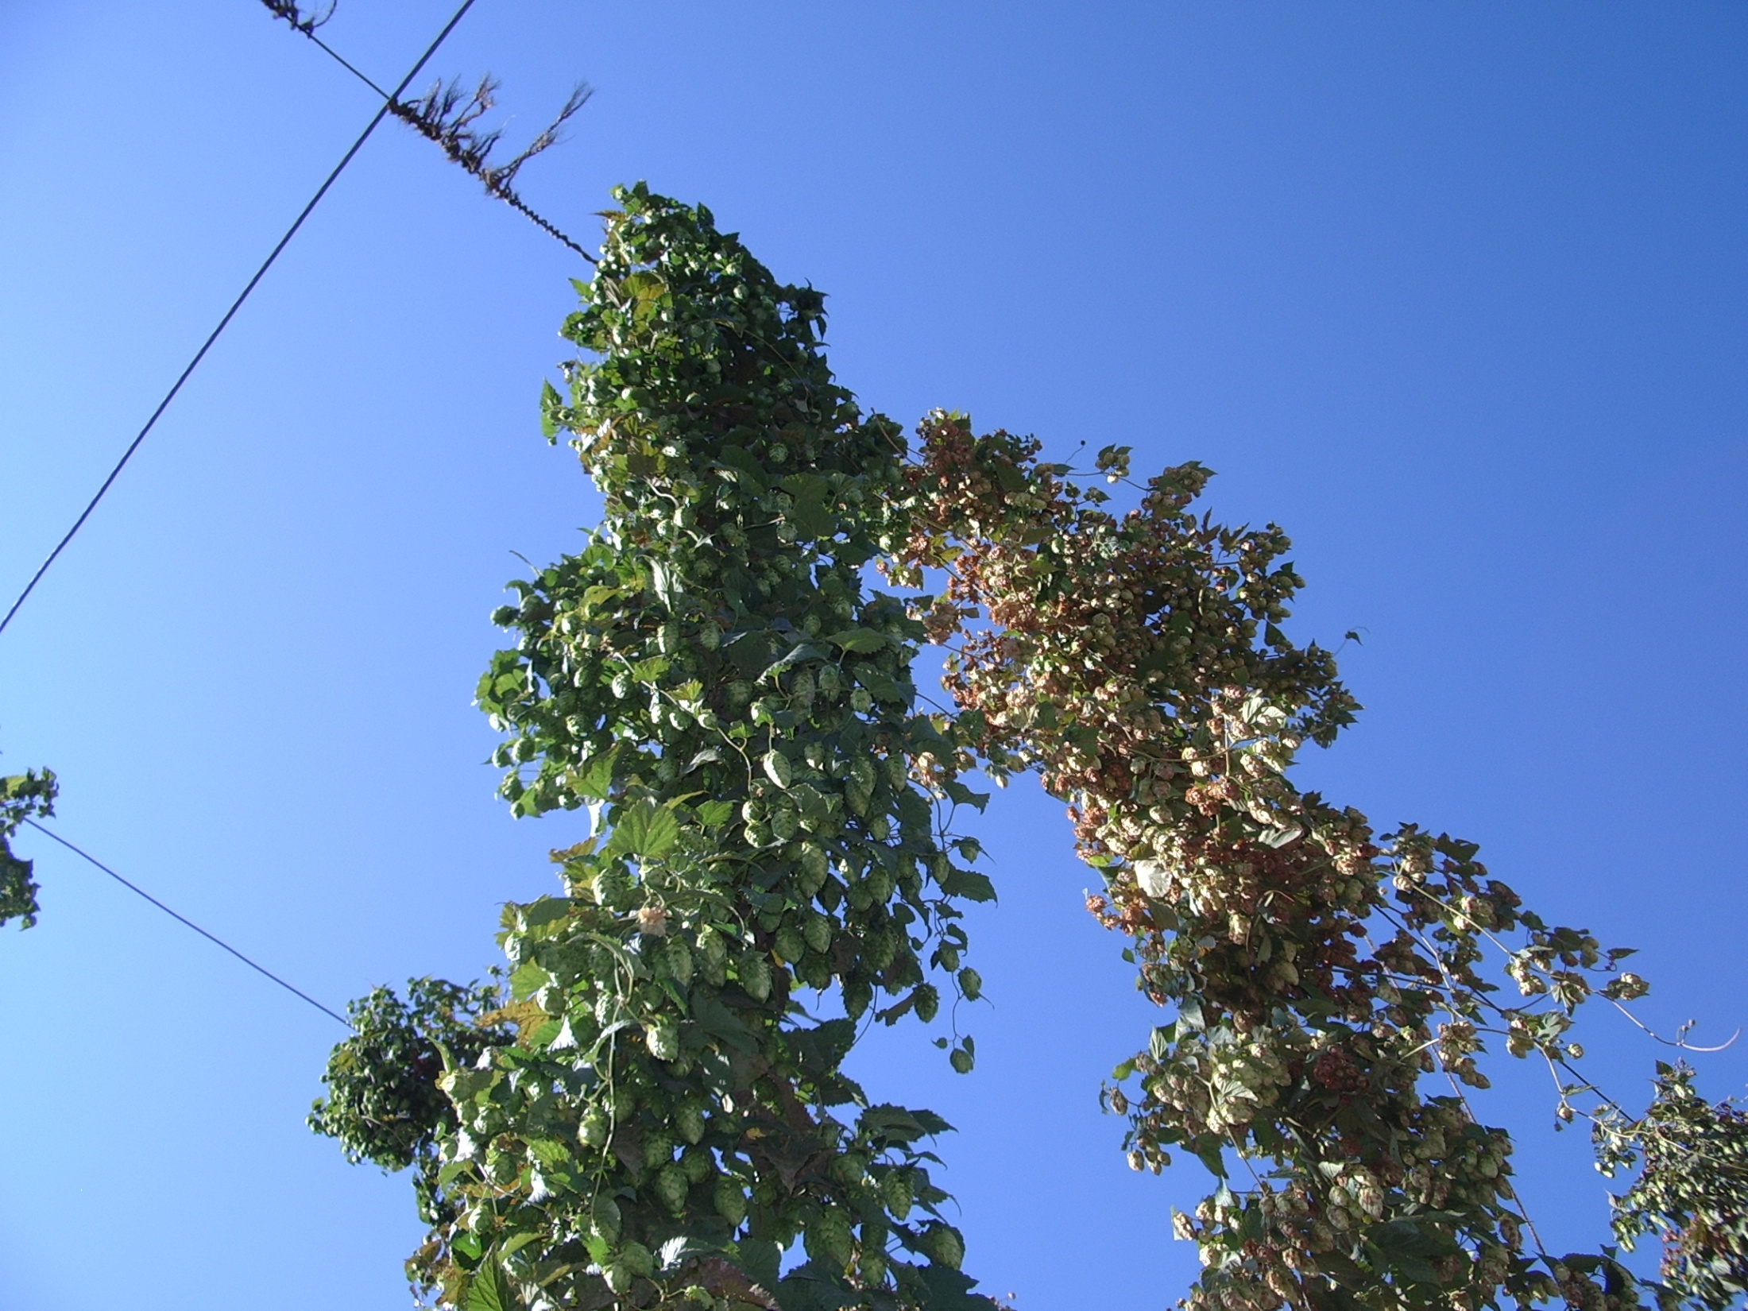
Breeding Objectives
High yielding high alpha cultivars.
  Super
  Varietal
High yielding aroma cultivars.
  Improvements on the classics
  Specialty / dual purpose
Goal is to combine the above with:
  Pest and disease resistance.
  Good storage stability.
  Desirable brewing characteristics (i.e. low cohumulone, specific oil components).

Slide 9
Humulus lupulus: Complexity
“Hops”
Dioecious, perennial, climbing vine
Indigenous to the Northern Hemisphere
  Origins in Europe:
    H. lupulus var. lupulus
  Origins in Asia (mainly Japan):
    H. lupulus var. cordifolius
  Origins in North America:
    H. lupulus var. pubescens
    H. lupulus var. neomexicanus
    H. lupulus var. lupuloides

Slide 10
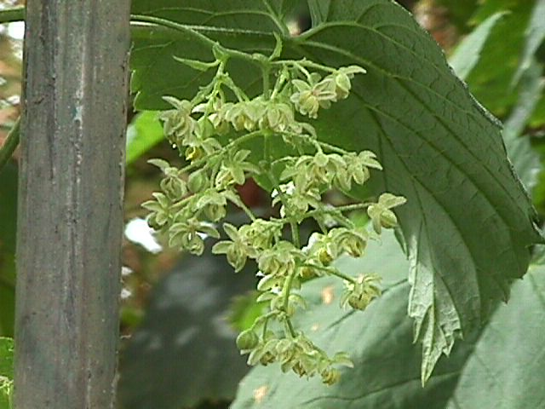
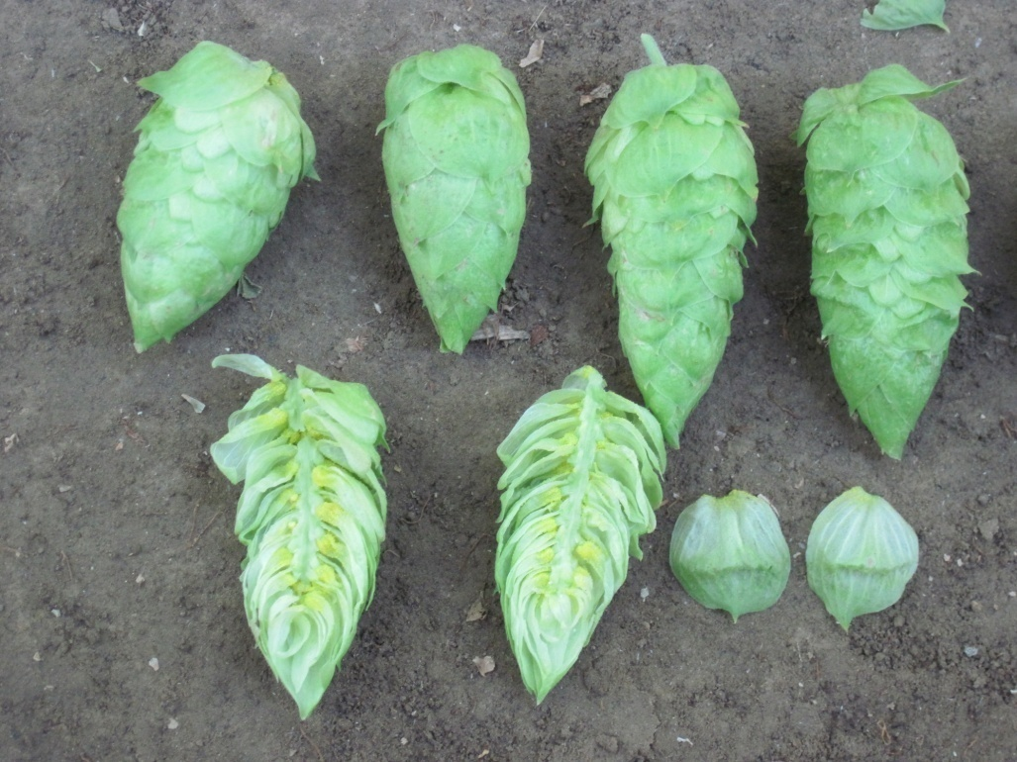
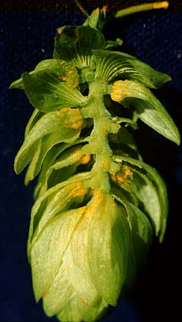
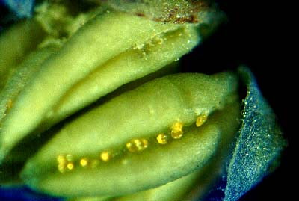
Humulus lupulus: Complexity
Dioecious (male and female plants).
  Genetically complex.
  Obligate out-crossers, cannot self pollinate.
    High level of diversity (heterozygosity).
    Hybrid vigor (Heterosis).
    Seed propagation not possible.
Annual above ground, perennial below.
Easily clonally propagated- traits can be “fixed” in single generation.
    Each new variety results from a single plant.
      Millions from one.
Mature Female “Cones”
Male flowers at anthesis

Slide 11
Mature Female “Cones”
Male flowers at anthesis

Slide 12
Hop Breeding Scheme
Year 1: Parental selection and crossing
Based on breeding objectives
Year 2: Early selection
Greenhouse screening
High density field screening
10% selection rate
Years 3,4,5: Intermediate selection
Remaining plants transplanted to 18’ trellis
1% selection rate
Years 6,7,8: Advanced selection
Expand selections to multi plant plots
2% selection rate
Years 9,10,11: Elite Trials
Selections expanded to commercial trials
Selection rate: ?
Year 11+: Commercialization

Slide 13
Population Dynamics
Year 1: Parental selection and crossing
Based on breeding objectives
Year 2: Early selection
10% selection rate
Years 3,4,5: Intermediate selection
1% selection rate
Years 6,7,8: Advanced selection
Start 40
3% selection rate
Years 9,10,11: Elite Trials
Selection rate: ?
Year 11+: Commercialization
Start 40,000
End 4000
Start 4,000
End 40
End 1.2
Start 2
Overall rate: 0.005%

Slide 14
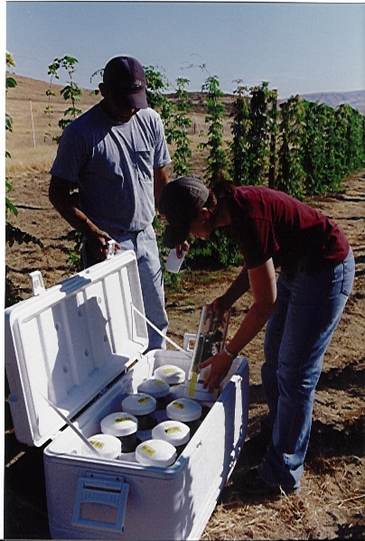
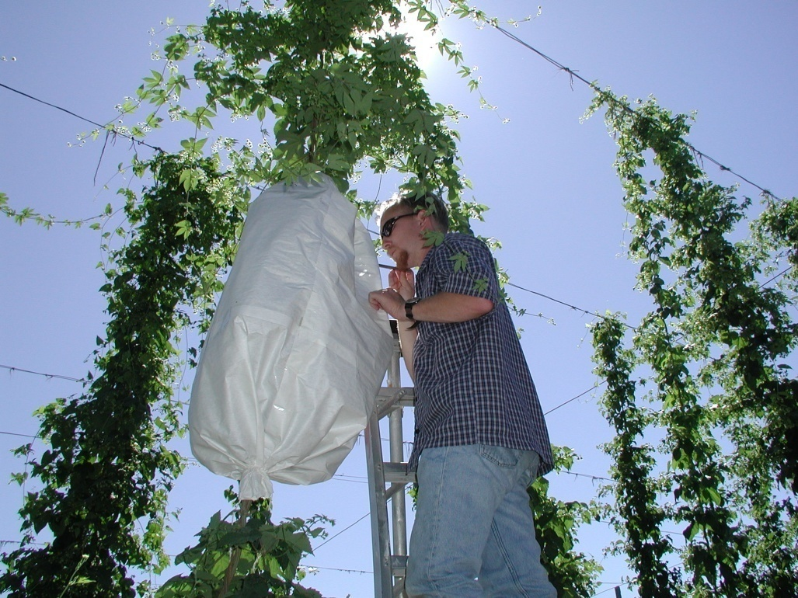
Crossing
Left: Collection of male flowers for isolation of
pollen.
Above: Application of pollen to a bagged
receptive female.

Slide 15
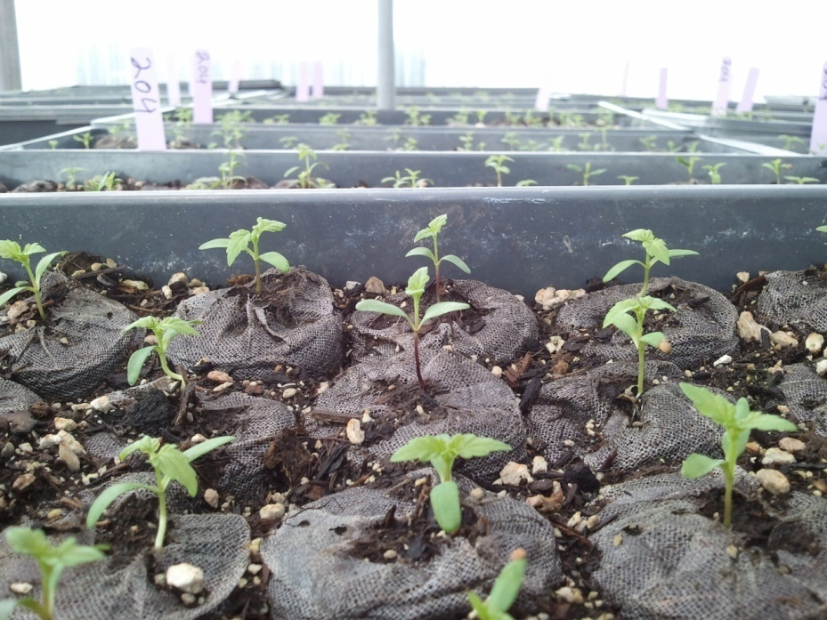
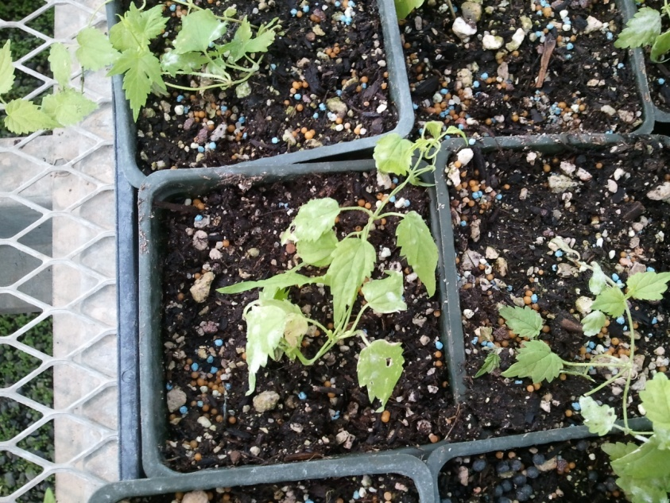
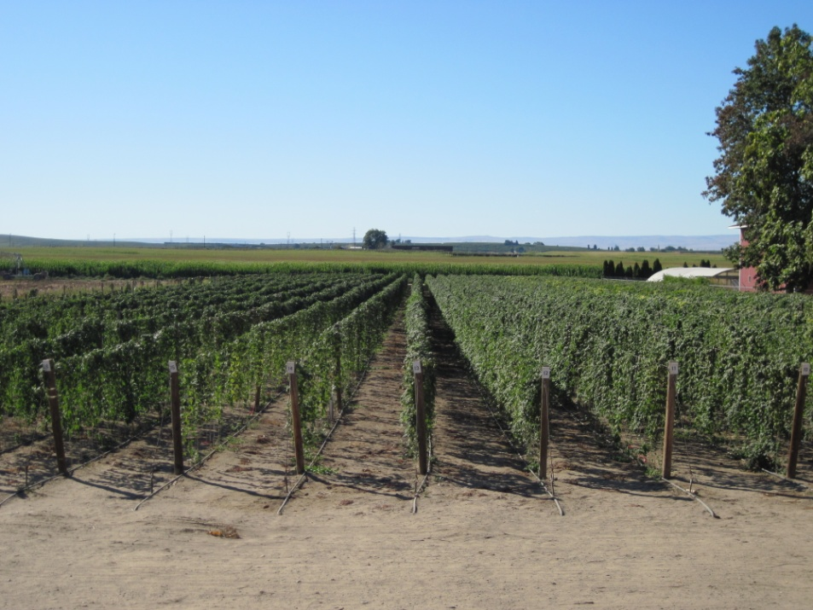
From Crosses to seedlings
Typically start with 20,000 – 50,000 genotypes in any given year.
Seedlings are screened in the greenhouse for Powdery Mildew, then planted to the field.
Typically eliminate 75 – 90% of the starting population.

Slide 16
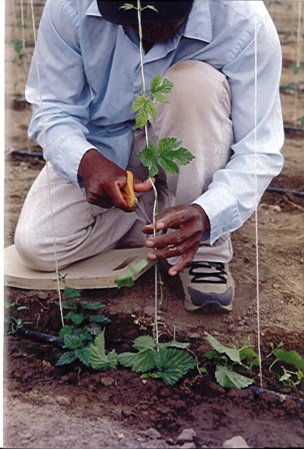
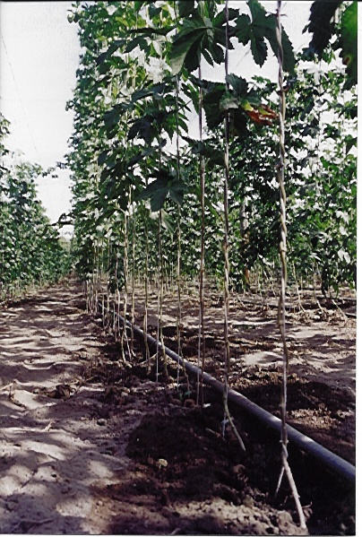

Slide 17
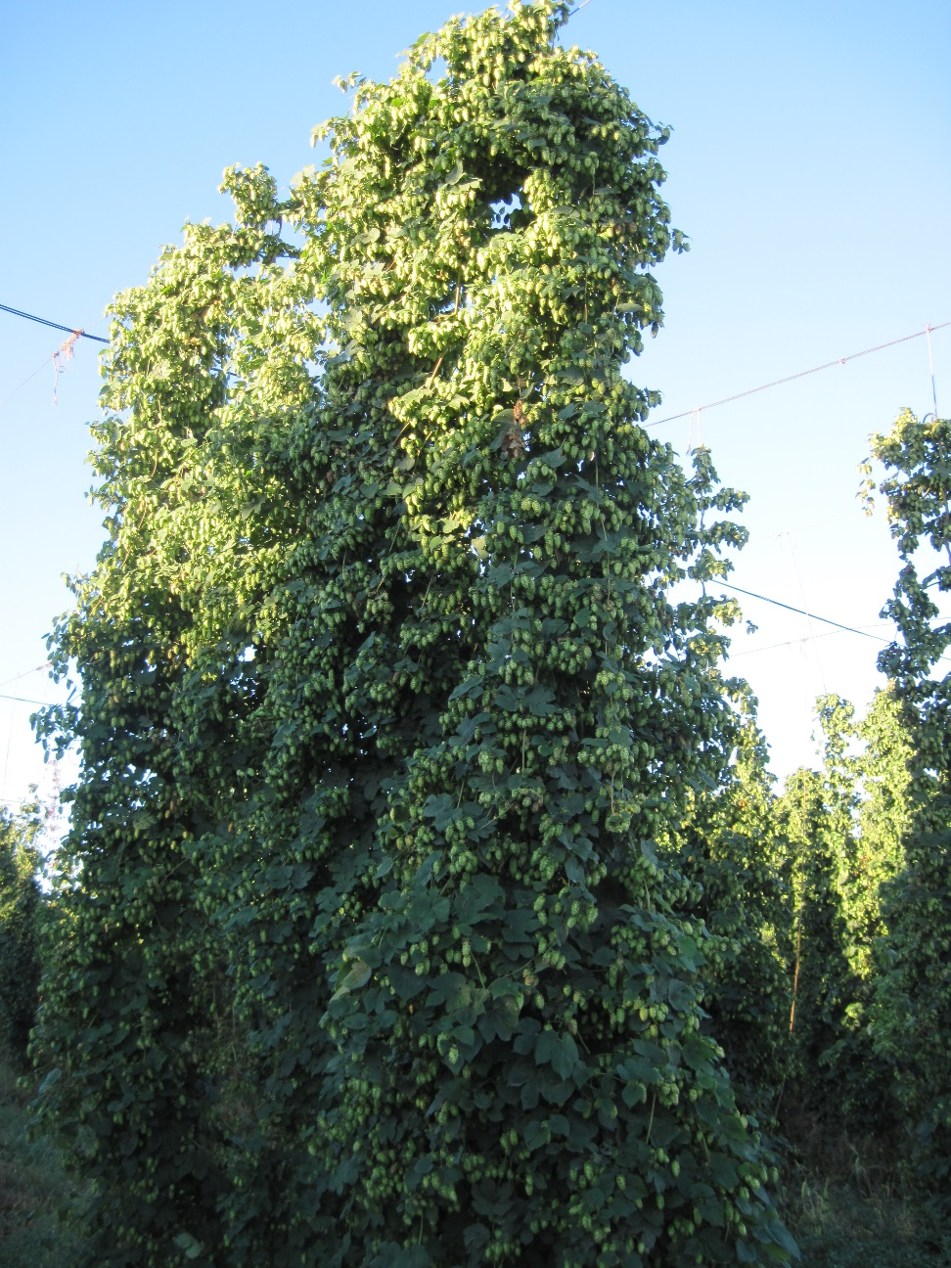
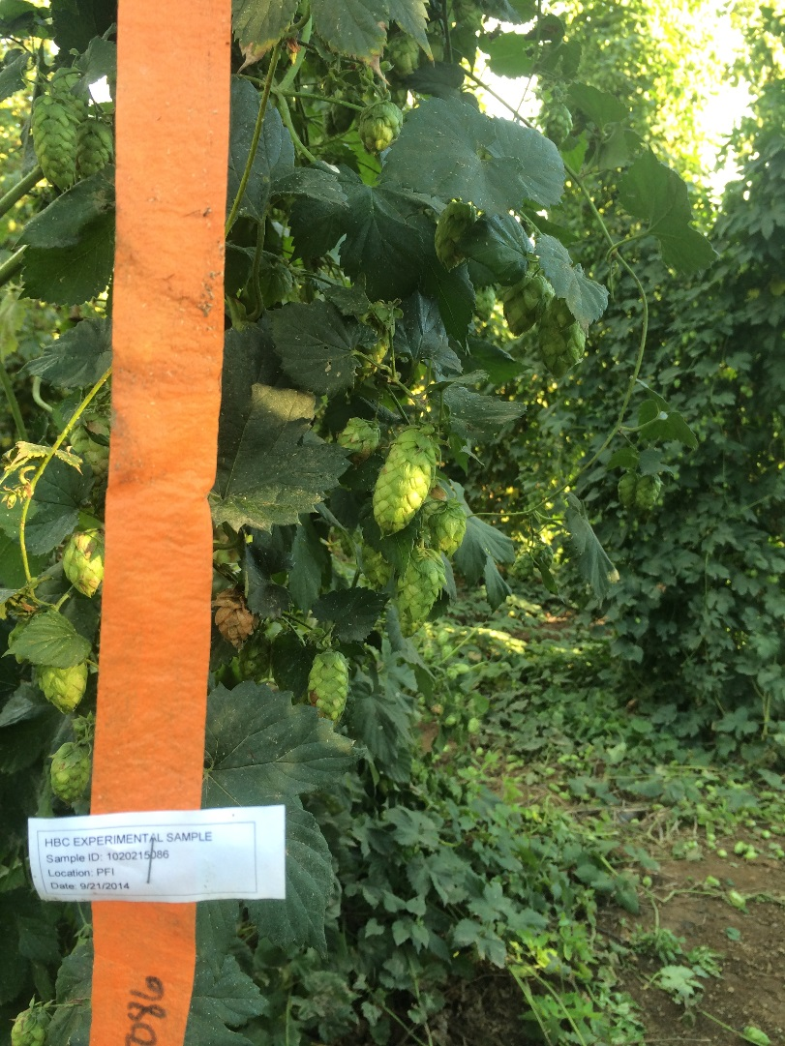
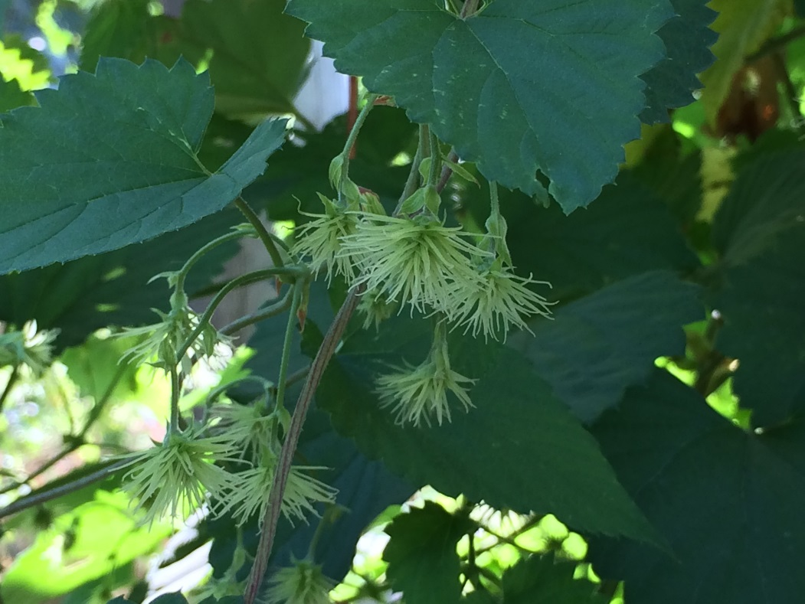
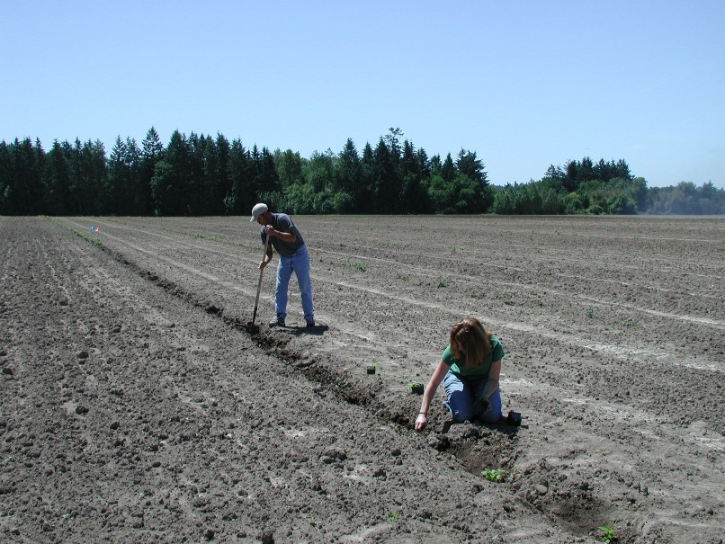

Slide 18
Cultivar Release: Year 11
After 8 - 10 years of evaluation, release is considered.
  Private varieties: PVP begins.
The work is far from over, success is dependant on:
  Continued agronomic success.
  Grower acceptance, usually short term.
  Brewer acceptance, long term.

Slide 19
Future Trends in Hop Breeding
Molecular research
  Marker assisted selection
  Gene mapping
  Gene functionality
Non-brewery usage
Continuing conversion to new varieties
  Driven by disease pressure, storage issues, basic economic pressures, and continued growth in craft brewing.
  Increases focus on AROMA

Slide 20
Acreage Trend: aroma versus alpha
Aroma hop acreage increasing
  Role reversal
Bitter/Alpha hops declining cyclically
Acreage at near record highs

Slide 21
Impact of Breeding: Top Varieties
Of the top 10
4 released since ‘00
28% of top 10
Including other >40%
USDA lists 41 varieties in ‘16
19 released since ‘00

Slide 22
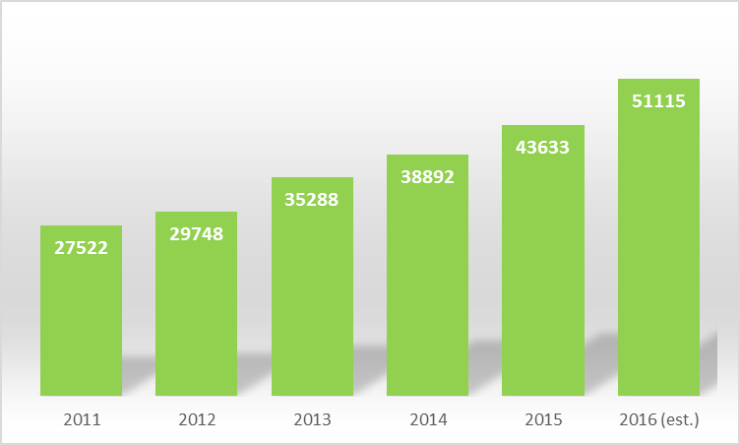
U.S. Hop Acreage
Est. 2016 Up > 7000 Acres (15%)

Slide 23
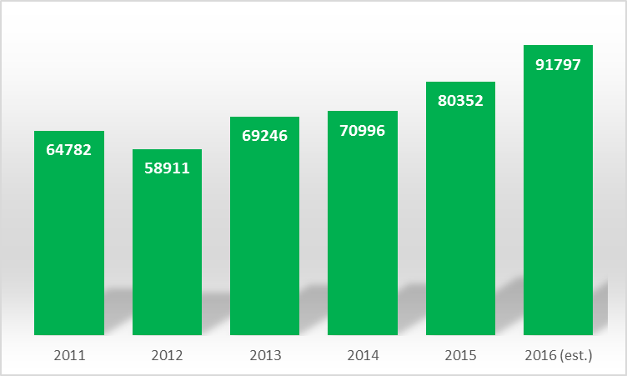
U.S. Hop Production (x1000)
Est. 2016 > 90MM

Slide 24
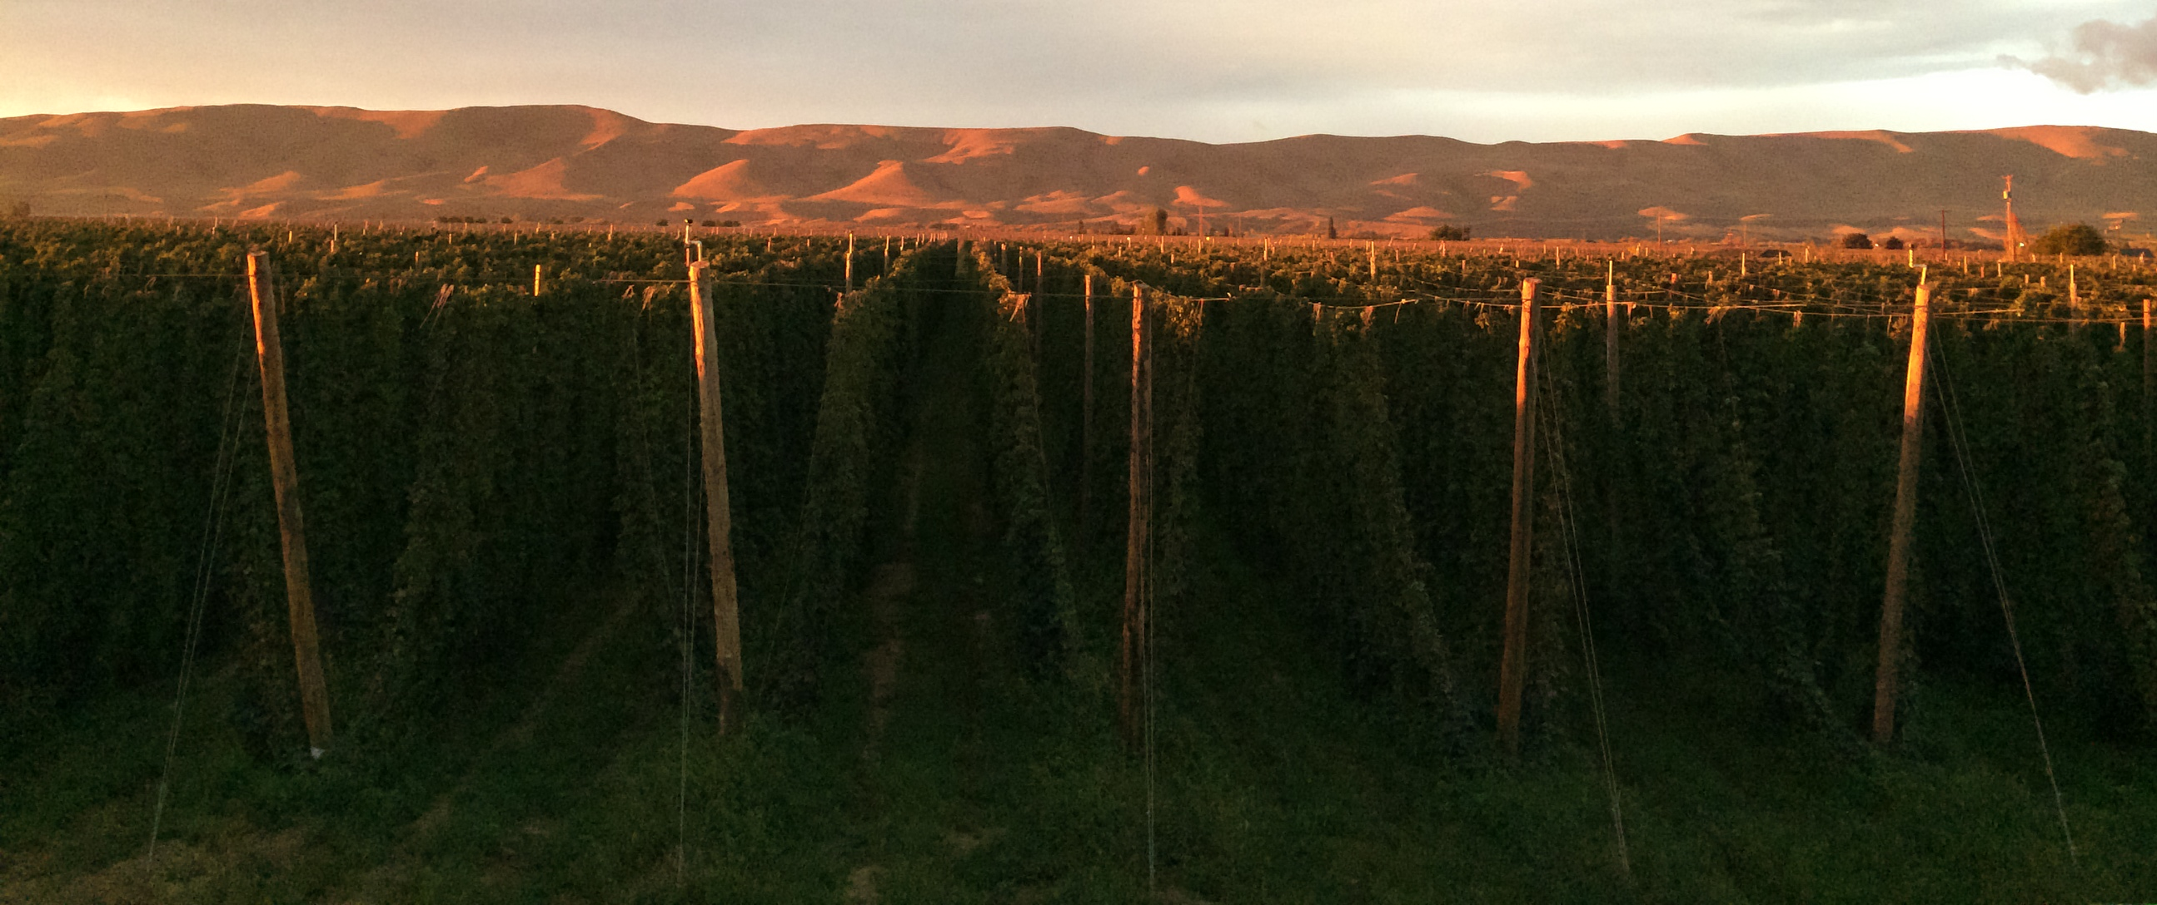
Thank you
jason@selecthops.com
All acreage and production data can be found at www.usahops.org

